Slide 1
Docker
&
Kubernetes (K8S)

Slide 2
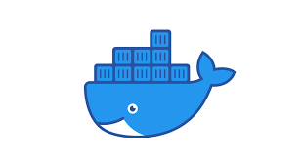
Why Docker ?

Slide 3
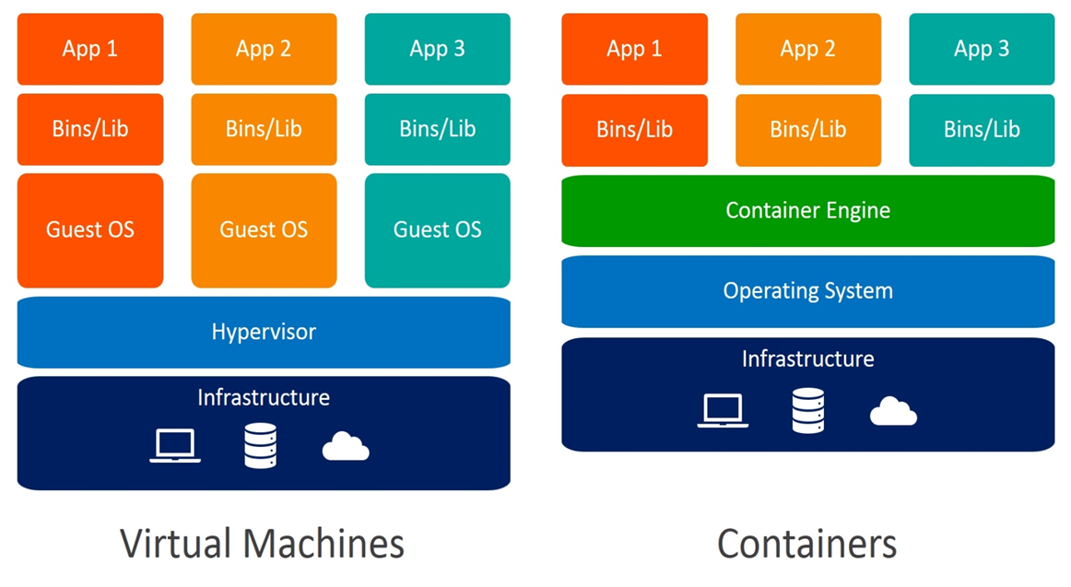
Before and After Docker

Slide 4
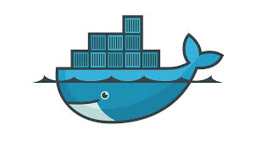
What is Docker?
Containerization platform.
Packages your application and dependencies.
Works in any environment.
Open source.
Run Any Type of Application

Slide 5
What is Container?
Isolated instance.
Self-contained.
Independent.
Runtime instances of images.
Portable.

Slide 6
Why Do We Need Containers
Consistency Across Environments
Isolation
Portability
Scalability
Resource Efficiency
Microservices Architecture
DevOps and CI/CD

Slide 7
What is Container Image?
Source of container
Describes a container environment
Contains all the files and dependencies
It includes the code, runtime, libraries, environment variables, and configuration files
Blueprint for containers
Immutable snapshots of applications

Slide 8
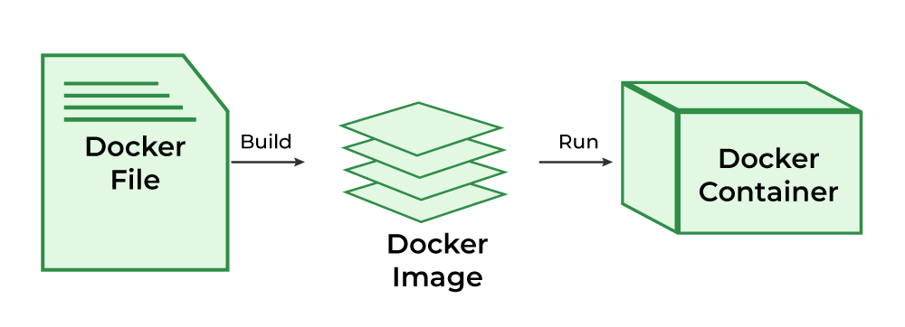
What is Dockerfile?
Text document
Series of instructions
Use to create application environment

Slide 9
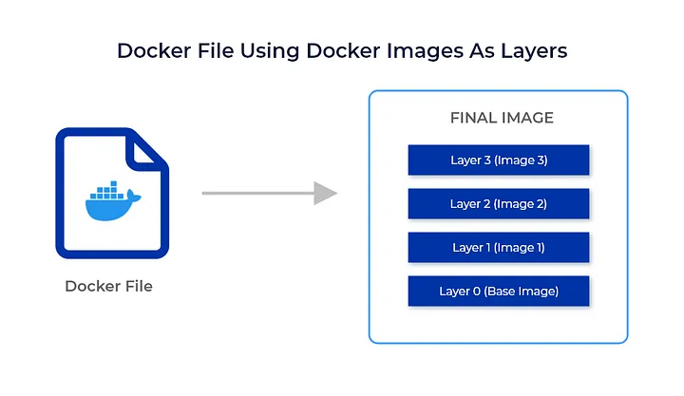

Slide 10
What is Registry?
Registry where docker images live
Users can pull pre-built images or push their custom images
Docker Hub
world’s largest public repository

Slide 11
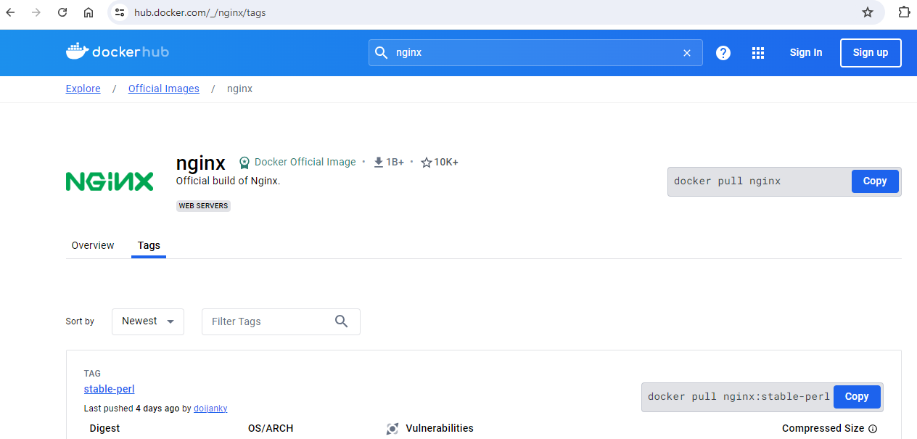
Example Of Docker Hub

Slide 12
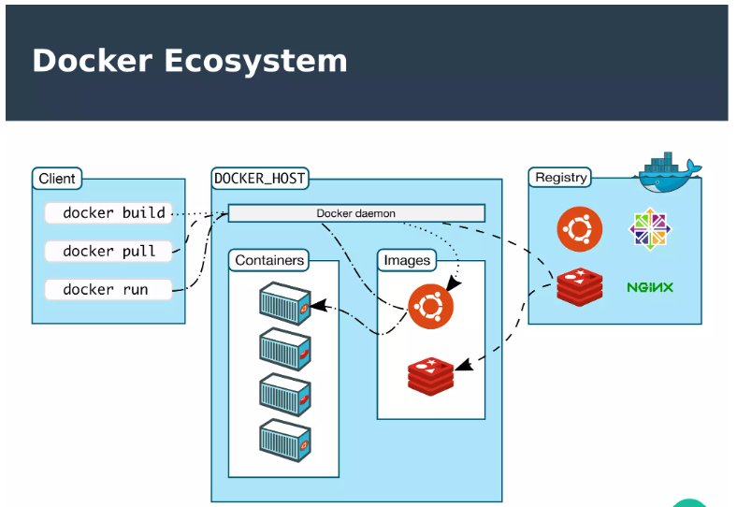

Slide 13
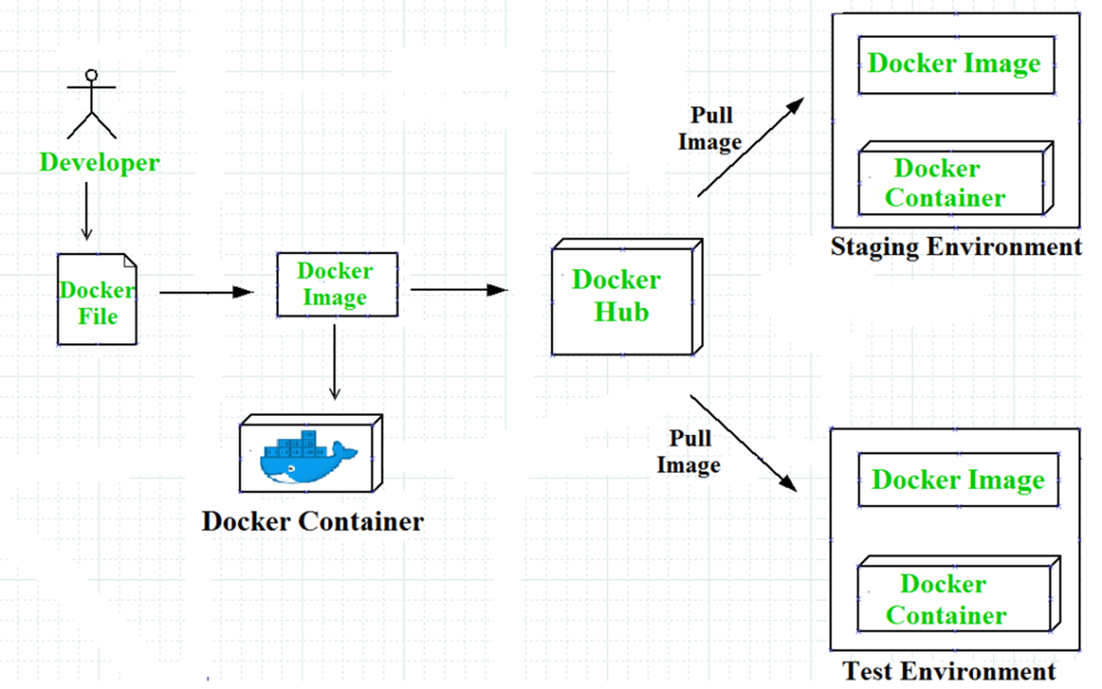
Docker Conatiner Overview

Slide 14
Examples of Docker containers

Slide 15
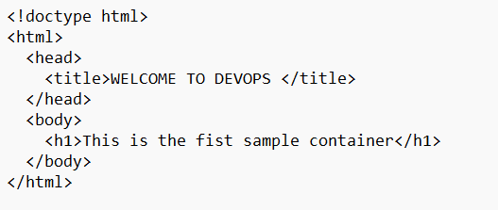
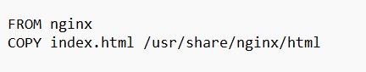
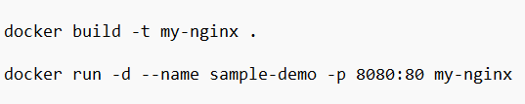
1.Create your first docker container from dockerfile.
Create sample Index.html file
Create Dockerfile to run index.html in container
Build Docker image from dockerfile and run the container:

Slide 16
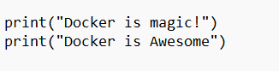
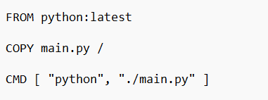
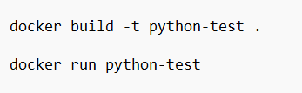
2.Create your second docker container from dockerfile.
Create sample main.py file
Create Dockerfile to run python application in container
Build Docker image from dockerfile and run the container:

Slide 17
Problem of Containers
Manual Management & Maintenance
Security
Upgradation
Downtime
Autoscaling
Migration

Slide 18
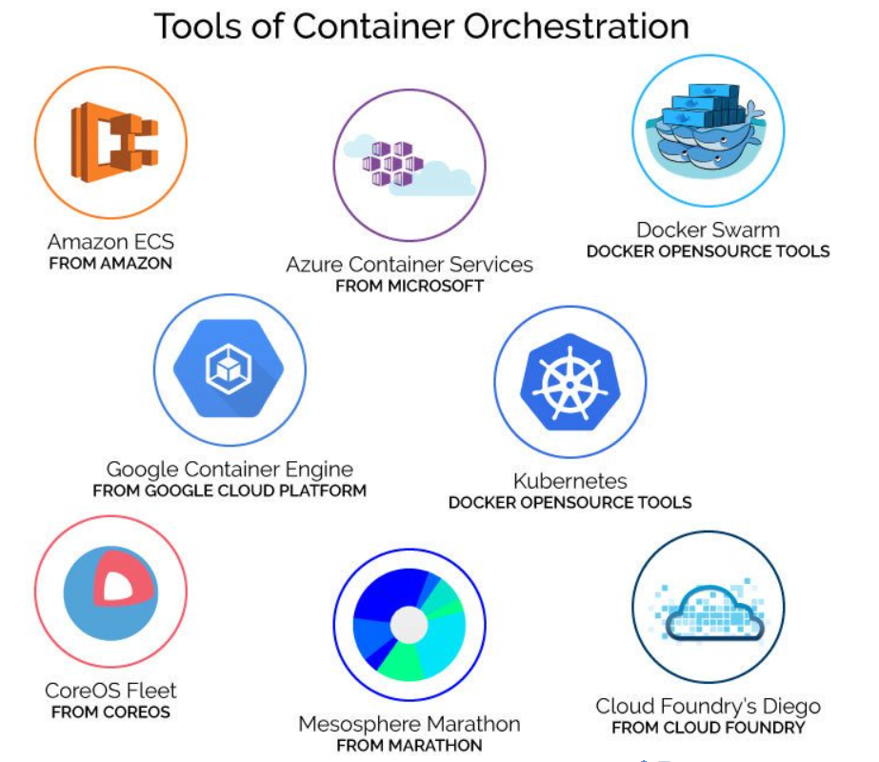

Slide 19
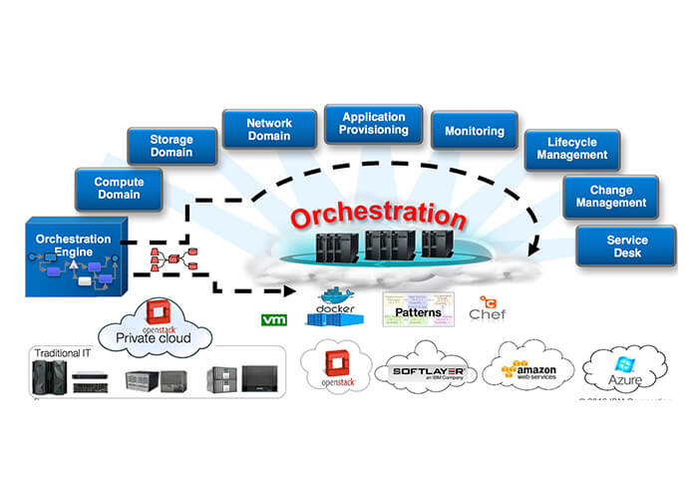
Orchestration

Slide 20
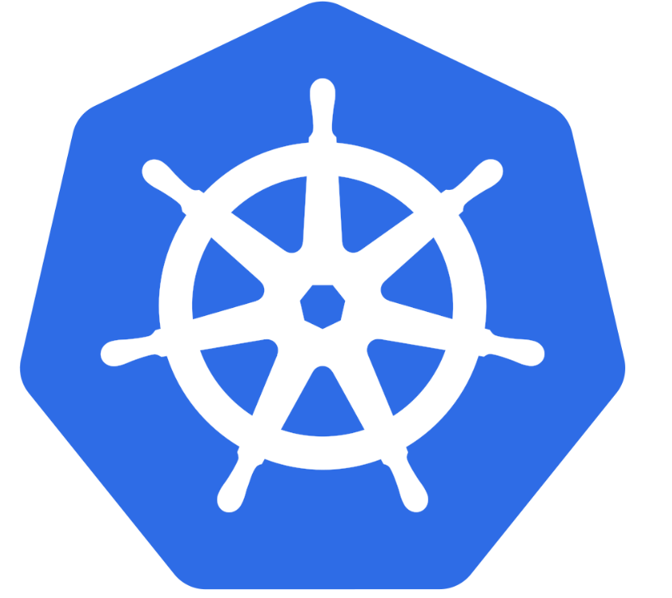
Kubernetes

Slide 21
Why Organizations Should Use Kubernetes ?
Better Management Through Modularity
IT Cost Optimization
Improve Scalability and Availability
Multi-Cloud and Hybrid-cloud Flexibility
Effective migration to the cloud
Less resource utilization

Slide 22
Agenda
What is Kubernetes?
Key Features of Kubernetes
Benefits of Using Kubernetes
Kubernetes Architecture
Basic K8S terminology
Use Cases and Success Stories
Getting Started with Kubernetes
Q&A

Slide 23
What is Kubernetes and why we need it ?
Open Source
Container orchestration System
Written in Golang
Designed By Google
maintained by the Cloud Native Computing Foundation (CNCF)
Automate Computer Application Deployment, Scaling and Management

Slide 24
What is container orchestration?
Provisioning and deployment
Configuration and scheduling
Container availability
Load balancing and traffic routing
Scaling and removing containers

Slide 25
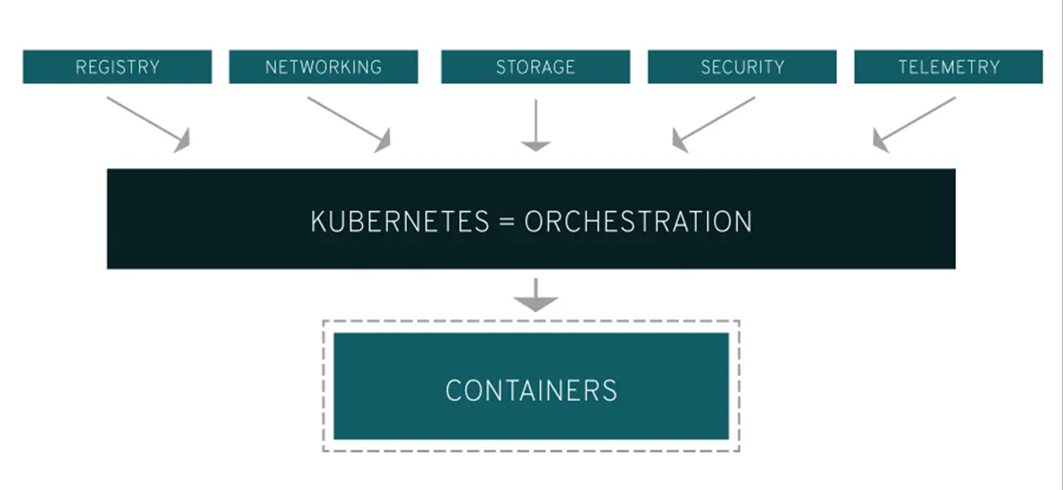

Slide 26
Key Features of Kubernetes
Automated Rollouts and Rollbacks
• Service Discovery and Load Balancing
• Storage Orchestration
• Automated Bin Packing
• Self-Healing
• Secret and Configuration Management

Slide 27
Benefits of Using Kubernetes
Scalability: Automatic scaling of applications based on demand.
• Portability: Consistent environment across different infrastructures.
• Resource Efficiency: Optimized resource utilization and cost management.
• Resilience: High availability and self-healing capabilities.
• DevOps Integration: Supports CI/CD pipelines and infrastructure as code

Slide 28
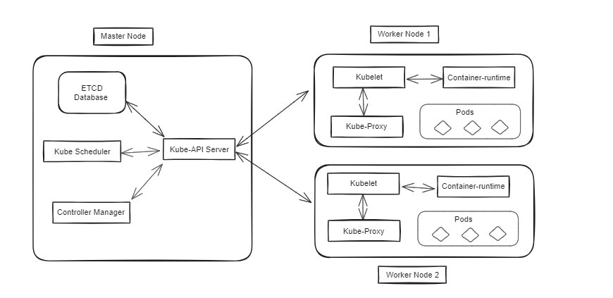
Kubernetes Architecture

Slide 29
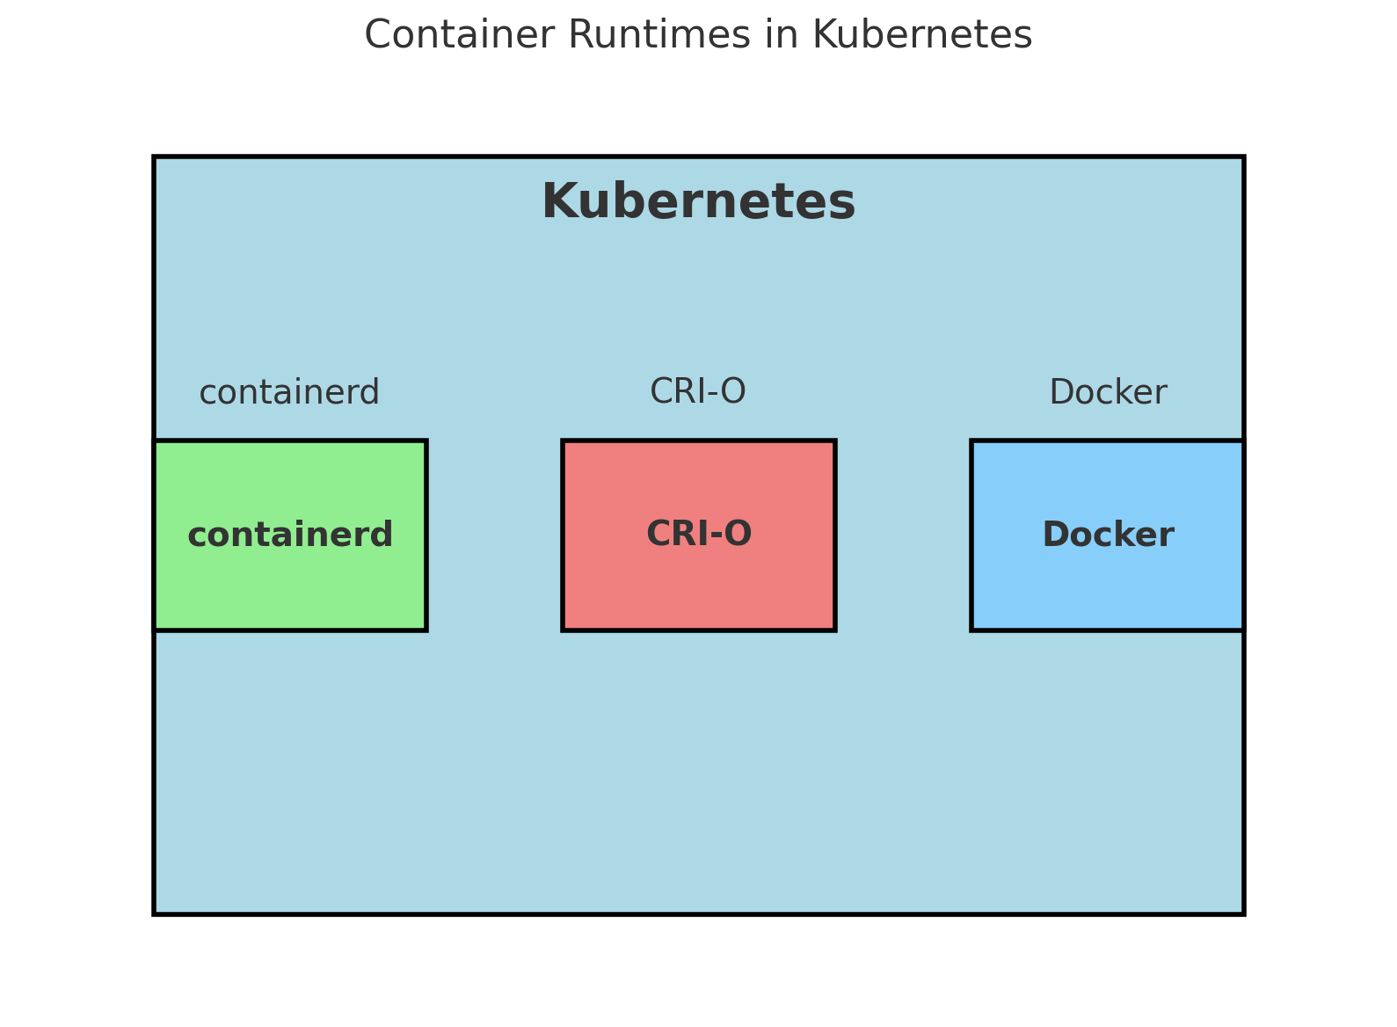
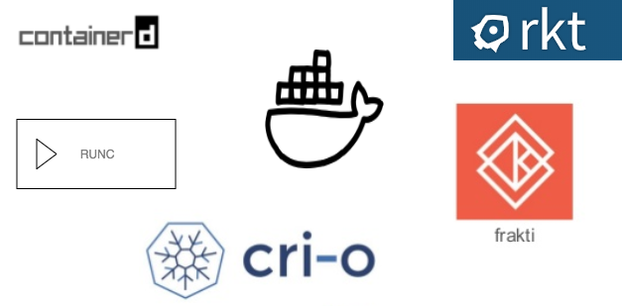
Container Runtimes

Slide 30
Basic K8S terminology
Cluster
Node
Pod
Service
Deployment
Replica Set
Secrets
Configmap
PV & PVC

Slide 31
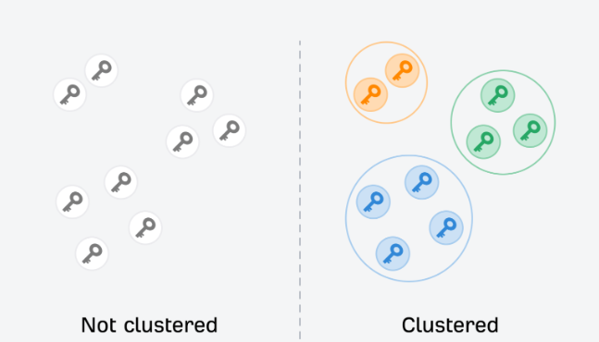
Cluster

Slide 32
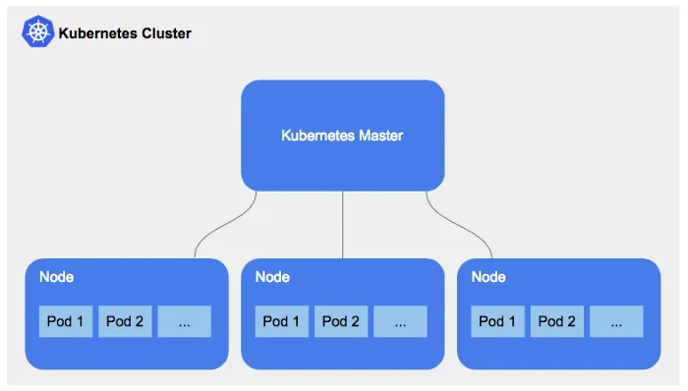
Kubernetes Multi-Node Cluster

Slide 33
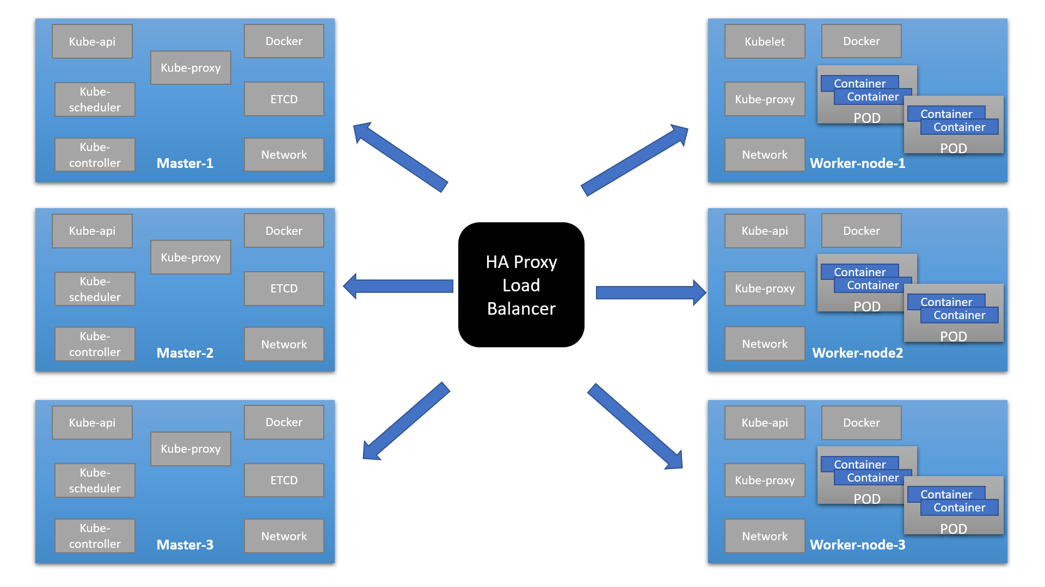
Kubernetes Multi-Master Cluster

Slide 34
Node
Main Worker Machines
Physical machine or VM
Necessary service to run POD
Manage by master

Slide 35
Pod
Smallest deployable units of computing
Collection of one or more containers
Smallest execution unit of a k8s application
Ephemeral in nature
Communication
Tightly coupled
Use shared resources

Slide 36
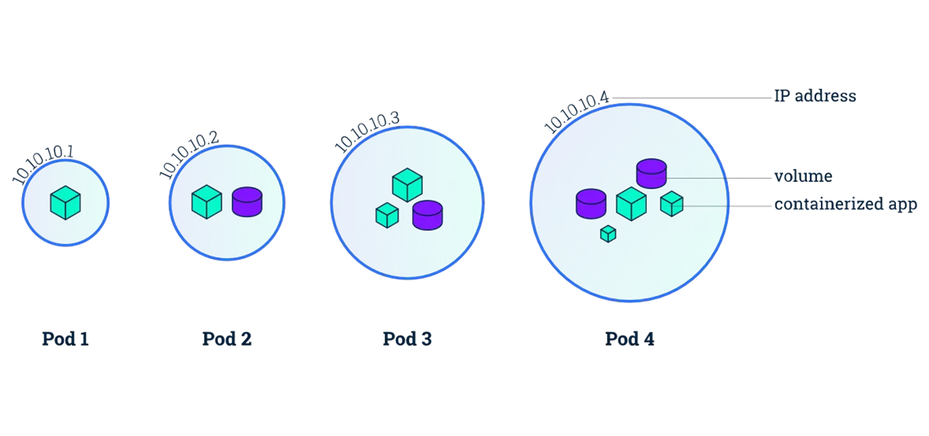

Slide 37
Service
Communication between the pods
Enables network access to a set of Pods
Service Types:
Cluster IP
Nodeport
Loadbalancer
External Name

Slide 38
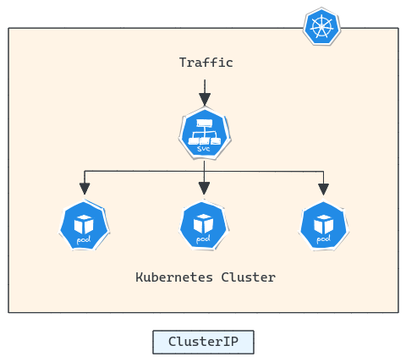
Cluster IP

Slide 39
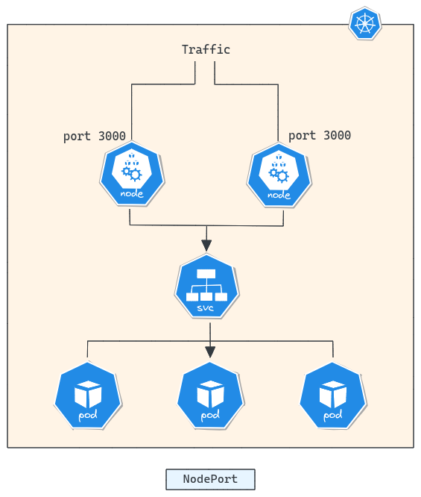
Nodeport

Slide 40
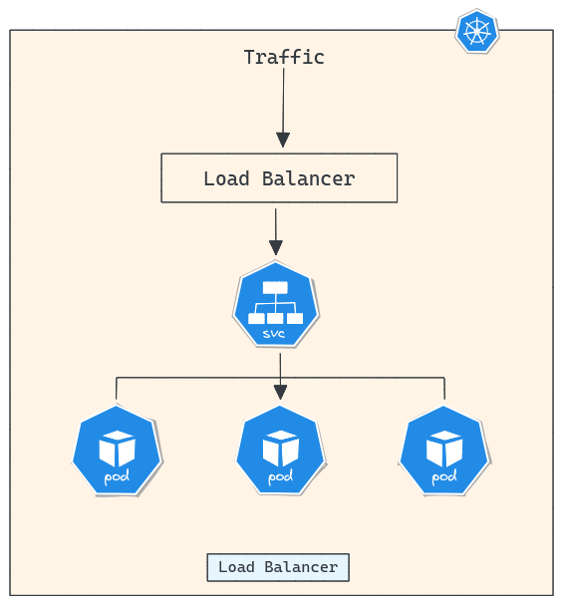
LoadBalancer

Slide 41
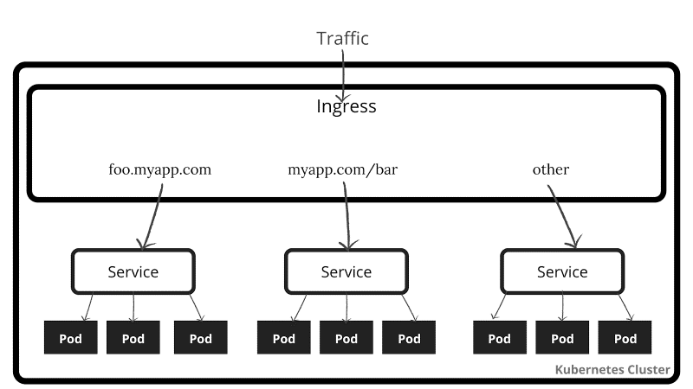
Ingress-Controller

Slide 42
Deployment
Describe the desired state
Deploy a replica set or pod
Update pods and replica sets
Rollback to previous deployment versions
Scale a deployment
Pause or continue a deployment

Slide 43
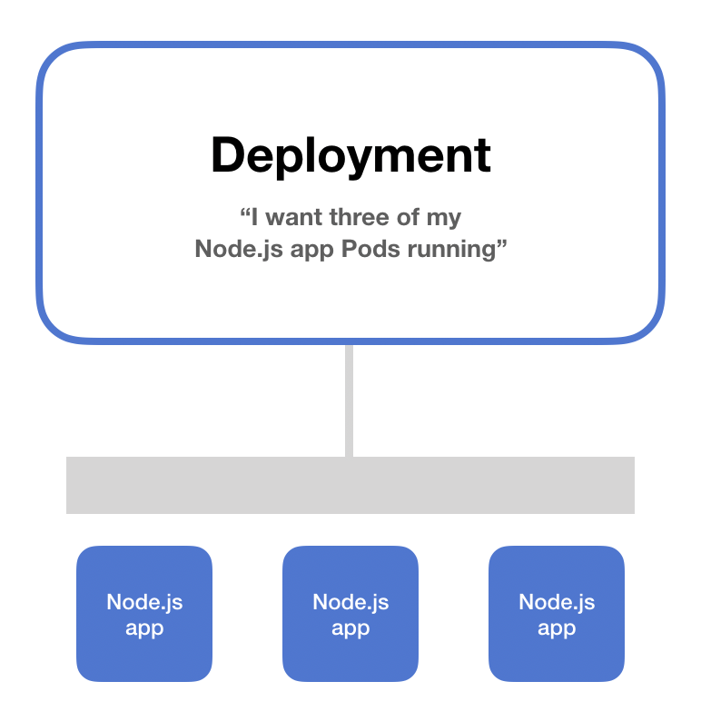

Slide 44
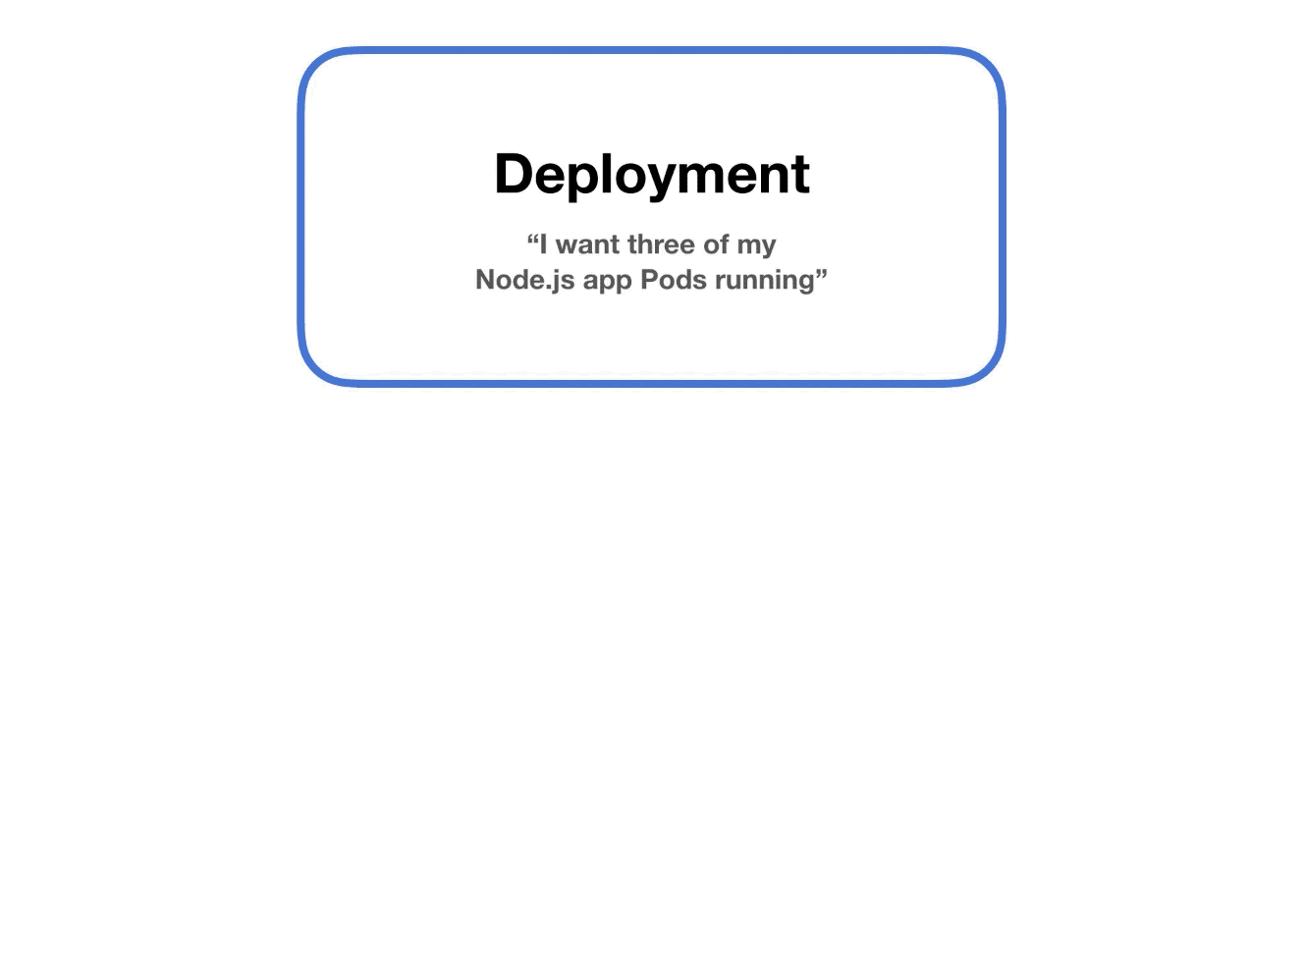

Slide 45
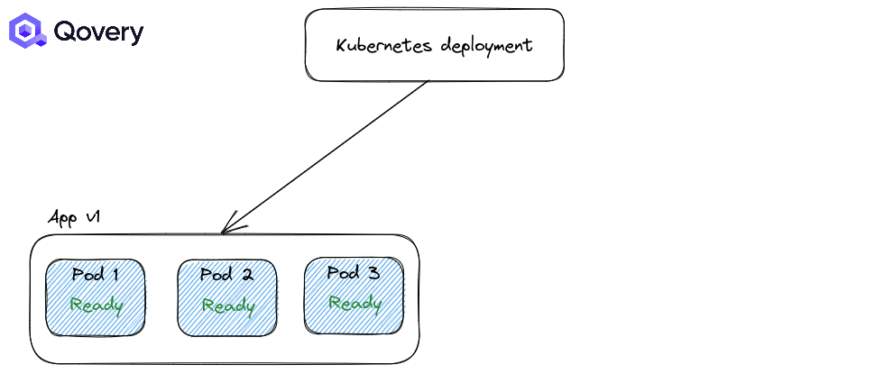
Rolling Update

Slide 46

Re-create

Slide 47
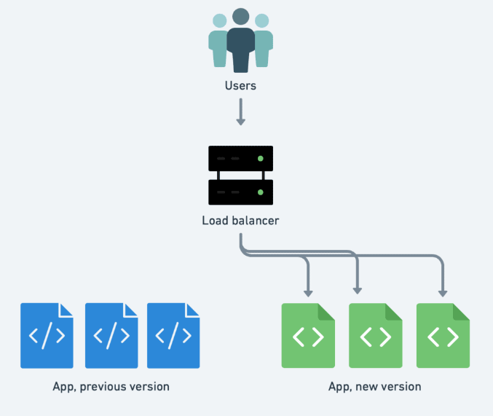
Blue/Green Deployment with Kubernetes

Slide 48
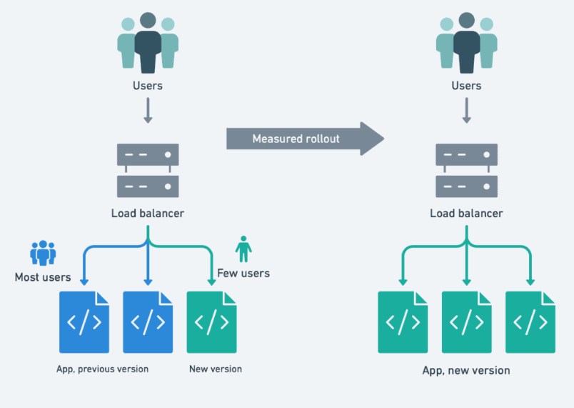
Canary deployment with Kubernetes

Slide 49
Secrets
Store confidential sensitive data
Passed as environment variables
Secrets deploy separately from Pods
Base64 encoded
Mounting them as a volume
Act as methods of authentication and authorization

Slide 50
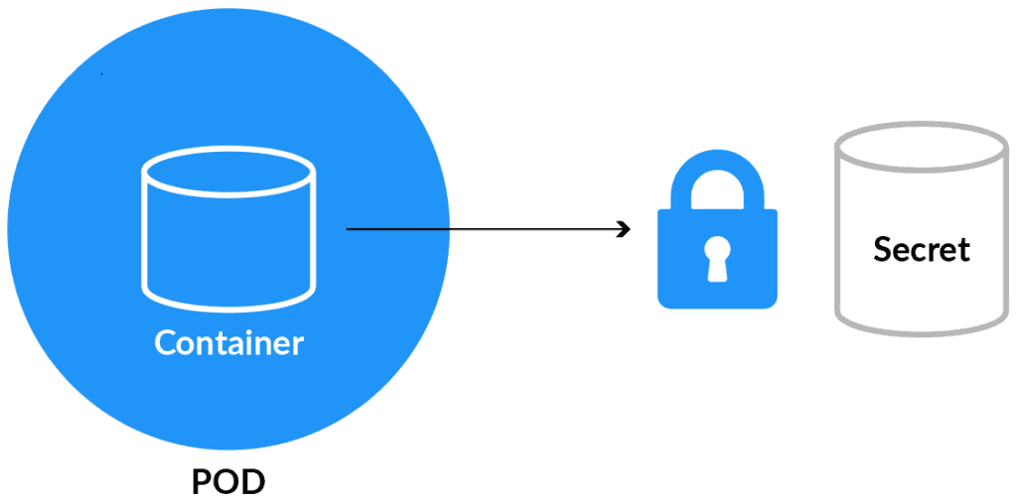

Slide 51
ConfigMap
Store non-confidential data
Consume CM as environment variables
Decouple environment-specific configuration
Does not provide encryption
Mount CM as volume

Slide 52
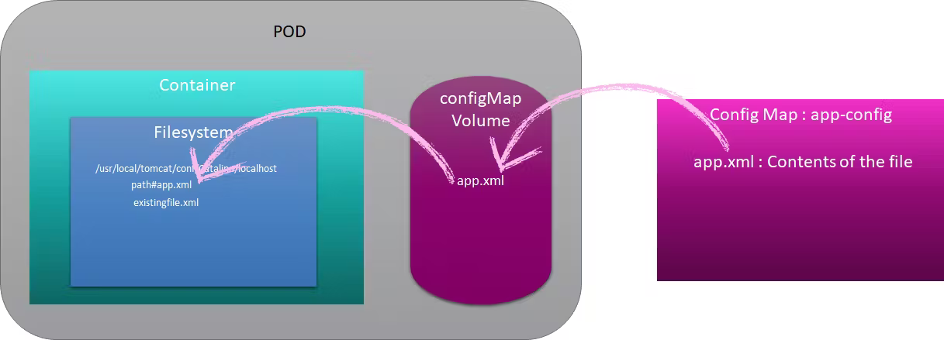

Slide 53
Persistent Volume
Piece of storage
Directory with some data
Independent from the POD
PODs live or die it can be reused
Many volume plugins based on the cloud service provider:
awsElasticBlockStore,
Azure Disk, AzureFile ,
cephfs, empty Dir , glusterfs ,
host Path, iscsi , local , nfs etc.

Slide 54
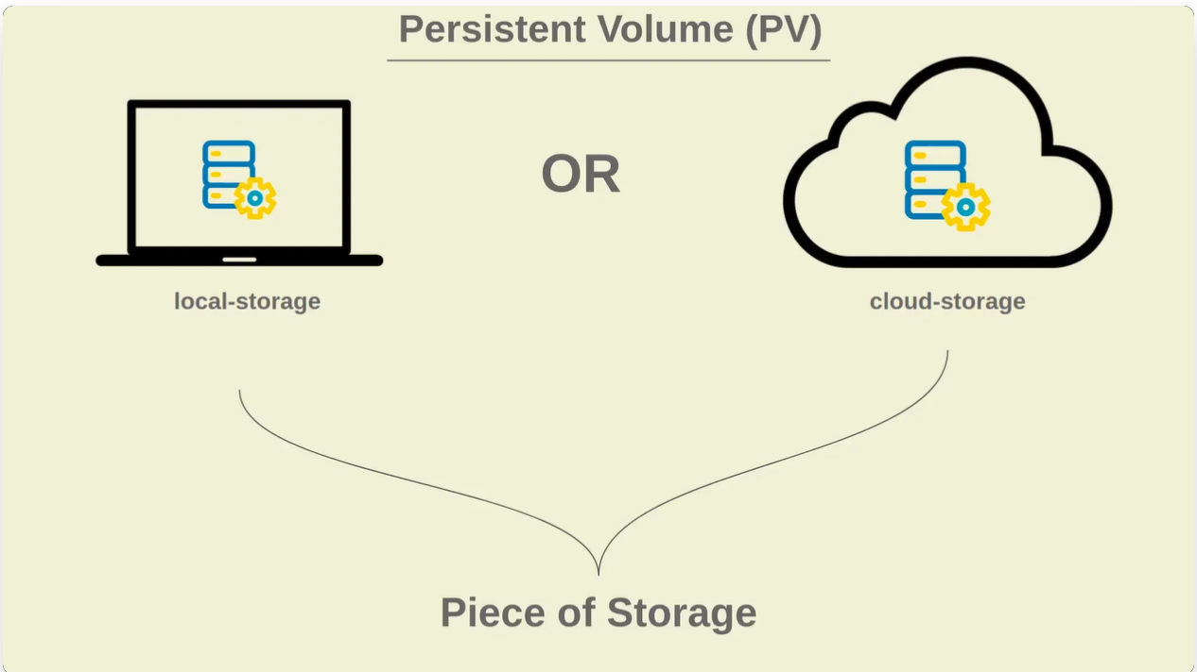

Slide 55
Persistent Volume claim
Abstraction between the consumption and implementation of the storage.
Request for storage on behalf of an application
PVCs consume PV resources.

Slide 56
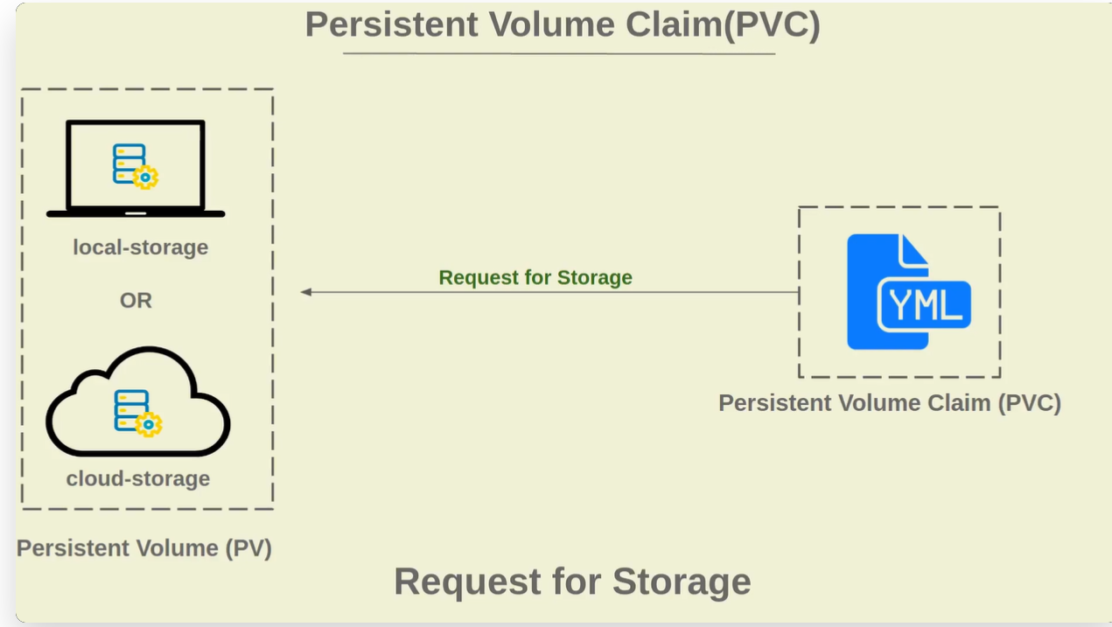

Slide 57
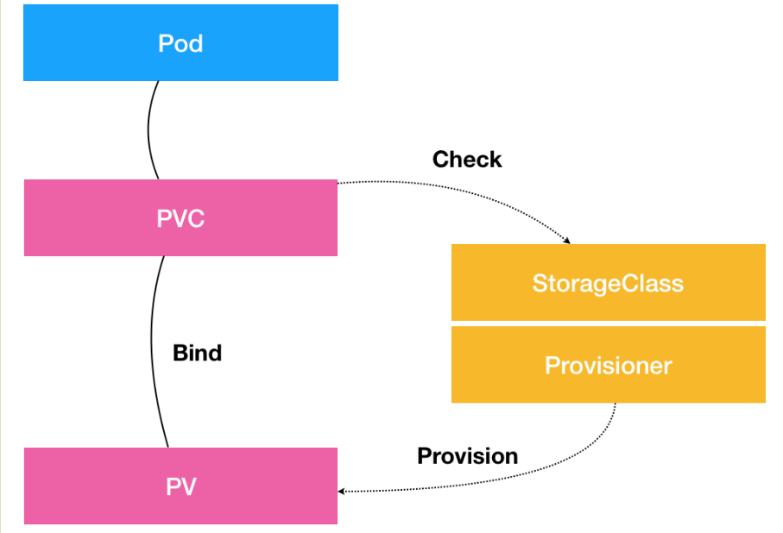
PV & PVC Overview:

Slide 58
Security in Kubernetes
Vulnerability Scanning
Enable Auditing
Limited access to nodes
Define Resource Quota.
Images from Authorized Repositories
Strict policy/rule for the resources
Restrict Access to ETCD

Slide 59
Use Cases and Success Stories
Simple App
Microservices
Lift And Shift Application
Machine Learning
Heavy Computing
CI/CD of Applications

Slide 60
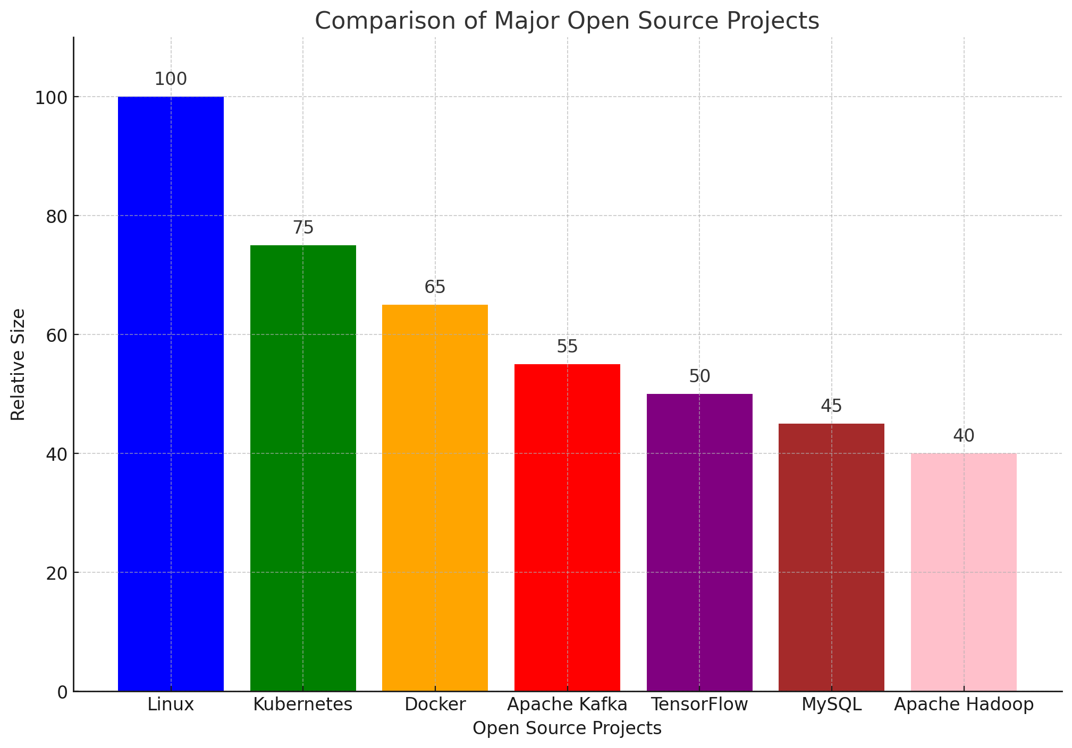
According to the CNCF, Kubernetes is now the second-largest open source project in the world just behind Linux.

Slide 61
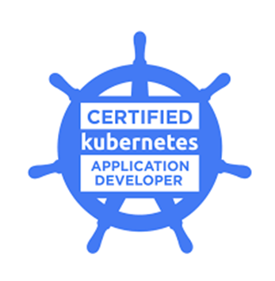
Certified Kubernetes Application Developer (CKAD) Certification?
Scope: This certification is aimed at Kubernetes application developers. It validates the ability to design, build, and deploy cloud-native applications for Kubernetes.
Key Areas:
Core concepts
Configuration
Multi-container pods
Observability
Pod design
Services and networking
State persistence

Slide 62
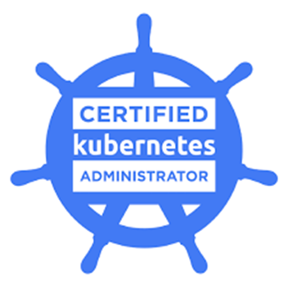
Certified Kubernetes Administrator (CKA) Certification?
Scope: This certification focuses on the skills required to be a Kubernetes administrator. It covers topics like installation, configuration, and management of Kubernetes clusters.
Key Areas:
Cluster architecture, installation, and configuration
Workloads and scheduling
Services and networking
Storage
Troubleshooting

Slide 63
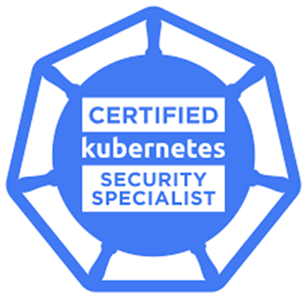
Certified Kubernetes Security Specialist (CKS) Certification?
Scope: This certification is for Kubernetes administrators, engineers, and security professionals who are responsible for securing container-based applications and Kubernetes platforms during build, deployment, and runtime.
Key Areas:
Cluster setup
Cluster hardening
System hardening
Minimize microservice vulnerabilities
Supply chain security
Monitoring, logging, and runtime security

Slide 64
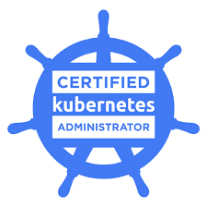
Role of Kubernetes Administrator?
A Kubernetes Administrator is responsible for the deployment, maintenance, and management of Kubernetes clusters.
They perform tasks such as:
Cluster setup and configuration
Troubleshooting
Scaling
Ensuring high availability of applications
Hardware configuration
Managing sets and storage
Creating and managing Kubernetes objects

Slide 65
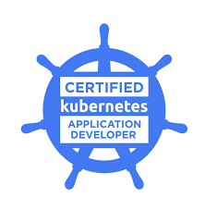
Role of Kubernetes Application Developer?
Kubernetes Application Developer can define application resources and use core primitives to build, monitor, and troubleshoot scalable applications and tools in Kubernetes.
Also Involve collaborating with cross-functional teams to ensure seamless integration and deployment of applications
They perform tasks such as:
Create the container infrastructure platform for the company
Coordinate with other infrastructure teams to meet goals
Enhance delivery systems with Continuous Integration
Improve the monitoring and alert system
Troubleshoot issues and solve problems where needed
Create and nurture highly available systems on Kubernetes

Slide 66
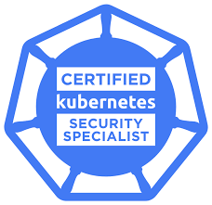
Role of Kubernetes Security Specialist?
A Certified Kubernetes Security Specialist (CKS) is an accomplished Kubernetes practitioner (must be CKA certified) who has demonstrated competence on a broad range of best practices for securing container-based applications and Kubernetes platforms during build, deployment and runtime.
They perform tasks such as:
Scanning Docker images for vulnerabilities
Investigating Kubernetes security with open source tools
Ensuring container immutability
Monitoring Kubernetes audit logs
Using CIS benchmarks to review the security configuration of Kubernetes components
Setting up ingress objects with security controls
Protecting node metadata and endpoints
Verifying platform binaries before deploying

Slide 67

Questions…?

